Slide 1
On the Criteria To Be Used in Decomposing Systems into Modules
by D.L.Parnas Dec. 1972
presented by Yuanhua Qu
for spring 2003 CS5391

Slide 2
On the Criteria To Be Used in Decomposing Systems into Modules
Overview
Benefits of modular programming
Modularization
KWIC Index Production System
KWIC Modularization1
KWIC Modularization2
Comparison of the Two Modularizations
The Criteria of Decomposition
Hierarchical Structure
Conclusion

Slide 3
Overview
Modularization
  a mechanism for improving the flexibility and comprehensibility of a system while allowing the shortening of its development time.
  Its effectiveness is dependent upon the criteria used in dividing the system into modules.

Slide 4
Overview
Decomposition
  Conventional decomposition
  Unconventional decomposition
    have distinct advantages for the goals outlined.
    Will be less efficient in most cases if implemented with the conventional assumption that a module consists of one or more subroutines

Slide 5
Benefits of modular programming
  Managerial
    Development time should be shortened because separate groups would work on each module with little need for communication.
  Product flexibility
    It should be possible to make drastic changes to one module without a need to change others.

Slide 6
Benefits of modular programming (continued)
  Comprehensibility
    It should be possible to study the system one module at a time.
    The whole system can therefore be better designed because it is better understood.

Slide 7
Modularization
The modularizations include the design decisions which must be made before the work on independent modules can begin.
In this context "module" is considered to be a responsibility assignment rather than a subprogram.

Slide 8
KWIC Index Production System
System accepts an ordered set of lines
Each line is an ordered set of words
Each word is an ordered set of characters
Any line may be circularly shifted by repeatedly removing the first word and appending it at the end of the line.
System outputs a listing of all circular shifts of all lines in alphabetical order.

Slide 9
KWIC
Two ways to modularize a program that generates KWIC indices.
  Modularization 1
    Based on the sequence of steps to perform
  Modularization 2
    Based on the principle of “information hiding”

Slide 10
KWIC Modularization1
Master control
Input
Circular Shift
Alphabetizer
Output
Characters
Index
Alphabetized
Index
Input medium
Output medium

Slide 11
KWIC Modularization 2
Master control
Input
Output
CSSETUP
CSCHAR(r,w,c)
WORDS(r)
ALPH
SETC(r,w,c,d)
ITH(i)
CHAR(r,w,c)
WORDS(r)
Lines
Circular Shifter
Alphabetizer
Input medium
Output medium

Slide 12
Comparison of the Two Modularizations
General
  Both might share the same
    data structures
    algorithms
    runnable representation (after assembly)
  Differences are in the way they are divided into work assignments and interfaces between modules.

Slide 13
Comparison of the Two Modularizations(continued)
General (continued)
  Systems are substantially different even if identical in the runnable representation
    runnable representation is used only for running
    Other representations are used for
      Changing
      Documenting
      Understanding , etc.

Slide 14
Comparison of the Two Modularizations(continued)
Changeability
Design decisions that may change
  Input format
  All lines stored in memory
  Pack characters 4 to a word
  Make an index for circular shifts rather than store them
  Alphabetize once, rather than either
      Search for each item as needed
      Partially alphabetize, partially search

Slide 15
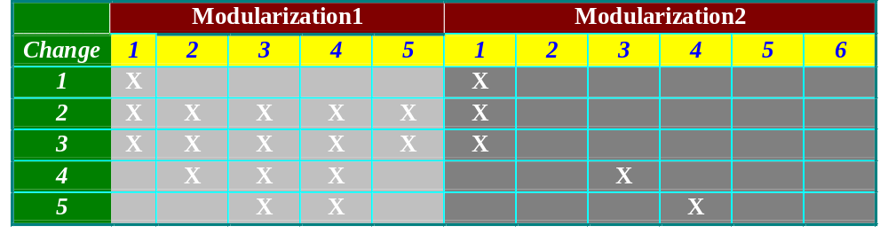
Comparison of the Two Modularizations(continued)
Changeability(continued)
  Modules:
    modularization1: 1. Input 2. Circular Shift 3.Alphabetizing
    4. Output 5. Master Control
    modularization2: 1. Line Storage 2. Input. 3. Circular Shift
    4.Alphabetizing 5. Output 6. Master Control
    X shows changes that needed in those modules corresponding to each kind of change.

Slide 16
Comparison of the Two Modularizations(continued)
Independent Development
  Modularization 1
    interfaces between modules are fairly complex.
  Modulariztion 2
    interfaces are relatively simple. Therefore independent development of modules should begin much earlier.

Slide 17
Comparison of the Two Modularizations(continued)
Comprehensibility
  Modularization 1
    The system will only be comprehensible as a whole.
  Modularization 2
    more comprehensible, better than modularization 1.

Slide 18
The Criteria of Decomposition
Modularization 1
  Each major step in the processing was a module
Modularization 2
  Information hiding
    Each module is characterized by its knowledge of design decisions which it hides from all others.
    Its interface or definition reveal as little as possible about its innter working.

Slide 19
Hierarchical Structure
The existence of the hierarchical structure assures us that we can "prune" off the upper levels of the tree and start a new tree on the old trunk.
If we had designed a system in which the "low level" modules made some use of the "high level" modules, we would not have the hierarchy, we would find it much harder to remove portions of the system, and "level" would not have much meaning in the system.

Slide 20
Hierarchical Structure(continued)
we must conclude that hierarchical structure and "clean" decomposition are two desirable but independent properties of a system structure.

Slide 21
Conclusion
It is almost always incorrect to begin the decomposition of a system into modules on the basis of a flowchart.
We propose instead that one begins with a list of difficult design decisions or design decisions which are likely to change. Each module is then designed to hide such a decision from the others.

Slide 22
Conclusion(continued)
To achieve an efficient implementation we must abandon the assumption that a module is one or more subroutines, and instead allow subroutines and programs to be assembled collections of code from various modules.
The end.

